Slide 1
Paper presentation
1.Bitcoin Transaction Graph Analysis (February-2015)
2. Uncovering the Bitcoin Blockchain: An Analysis of the Full Users Graph (October-2016)
Presenter: Amandeep Singh
BDA 7570/4060

Slide 2
Authors
Bitcoin Transaction Graph Analysis
Michael Fleder (mfleder@mit.edu)
Michael S. Kester (kester@eecs.harvard.edu)
Sudeep Pillai (spillai@csail.mit.edu)
Uncovering the Bitcoin Blockchain: An Analysis of the Full Users Graph
Damiano Di Francesco Maesa, Department of Computer Science, University of Pisa, Italy (damiano.difrancescomaesa@for.unipi.it)
t Andrea Marino, Department of Computer Science, University of Pisa, Italy (marino@di.unipi.it)
Laura Ricci, Department of Computer Science, University of Pisa, Italy(laura.ricci@unipi.it)
BDA 7570/4060

Slide 3
Bitcoin Transaction Graph Analysis- Discussion Points
Basic Idea
Methodology
Implementation
Use cases
BDA 7570/4060

Slide 4
Basic Idea
The paper explores the ways to link user information with transactional graphs build using publicly available bitcoin blockchain data.
The approach executes in 2 steps:
Annotate public transaction graph by linking bitcoin public keys to real people.
Run annotated graph through graph analysis framework to find user activities.
BDA 7570/4060

Slide 5
Outcomes
In result to Graph Analysis of annotated graph we get characteristics of user activities like:
Most important nodes in the network.
We can analyze the assets of Users.
We can analyze the movement of assets of user.
Nodes with large volume transactions.
communities
Single large entities
BDA 7570/4060

Slide 6
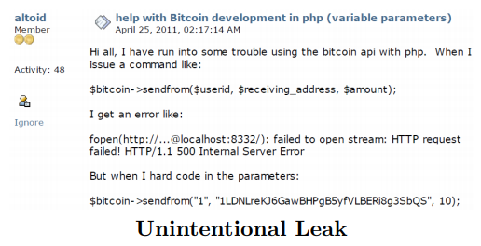
Methodology
The paper proposes to extract bitcoin public keys from online forums using web scrapping as people might have unintentionally or intentionally leaked their addresses.
For e.g. Silk Road owner Dread Pirate
Roberts unintentionally reveals his
public key in an online forum
bitcointalk.org
BDA 7570/4060

Slide 7
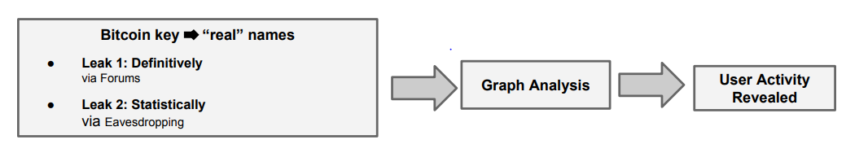
Other scenario can be where attacker over hear about transaction like (“real” name, some rough transaction info) pairs.
Next is Building Entity graph and run it through graph analysis framework for deanonymize user activities.
BDA 7570/4060

Slide 8
Implementation
Parsing and Web scrapping:
Downloads the torrent of blockchain available then for faster downloading, update rests using bitcoin client.
Used armory with written wrapper class to parse through blockchain and extract information required to build transaction graphs.
Scrappy python package was used for scrapping bitcoin addresses from public forums. Which were then validated. After running it for 30 Hours the results were:
Posts with validated address | Unique Users | Validated Addresses
89,088 | 2,322 | 2,404
BDA 7570/4060

Slide 9
Transaction Fingerprinting:
consider that attacker overheard some transaction and now wants to map in transaction graph.
For this he will make some time and money window according to the characteristics from overheard transaction.
E.g. , if we overhear Bob telling Alice, I sent you $100 USD yesterday at noon. Then we create window for this transaction like[$99,$101] and [11:55 AM, 12:05 PM].
So probability of transaction in that gap would be = 1/ total no. of transaction in that gap.
BDA 7570/4060

Slide 10
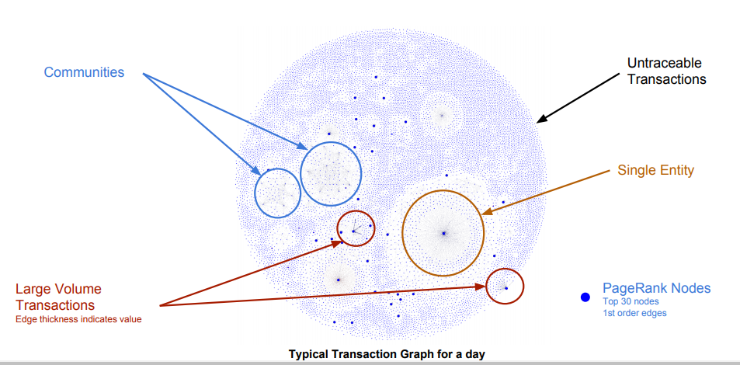
Graph Analysis:
First step includes building transactional graph from parsed blockchain data.
From the transaction graph Directed User graph was built on using collected user information.
Because of similarity of structure between user graph and search engine graphs PageRank method was used to rank the nodes.
The Resulting entity graph provides an insights on the network like communities, single entities, and large volume transactions.
BDA 7570/4060

Slide 11
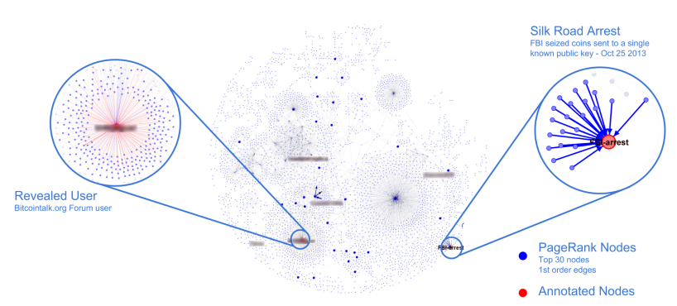
Use Case
First step int the experiments was to build Transactional Graph for Oct 25, 2013.
Using that transaction graph Directed User graph was built.
Because of similarity of structure between user graph and search engine graphs PageRank method was used to rank the nodes.
Using top Page Ranked nodes algorithm was able to pickup the transactions where FBI sized Silk Road Funds
BDA 7570/4060

Slide 12
Uncovering the Bitcoin blockchain: an analysis of the full users graph - Discussion Points
Basic Idea
Methodology
Analysis
BDA 7570/4060

Slide 13
Basic Idea
The paper proposes first scalable algorithm for analysis of user graphs after exponential increase in transactions by 2016.
The idea was to keep all the data of bitcoin transactions and create user graph algorithm which was scalable and does not get affected from growth in transactions.
Do graph Analysis on built user graph to infer insights on the network and transactions.
Examine the evolution of bitcoin network and nodes over time.
BDA 7570/4060

Slide 14
Methodology
For collecting data by parsing blockchain, standard script types used were p2pkh,p2ppk and p2sh.
First step after collecting the data is building the user graph. For which all the addresses belong to user are clustered to correspond to a single user.
Clusters are built using the proposed algorithm in paper. After identifying clusters weighted multigraph is built between those.
In Graph analysis main focuse was given to 3 parts:
Connectivity Analysis Over Time
Centrality Analysis
Richness of node over time.
BDA 7570/4060

Slide 15
Analysis
Implementation
Blockchain Data is parsed for extracting required data for building the graph.
From the bitcoin address, transaction weighted directed hypergraph, all the addresses managed by a single user are added to one cluster which represents the user.
Once clusters identified weighted multigraph is created as there can be many transactions from one cluster to another.
Clustering statistics shows that Cluster frequency is inversely proportional to its size.
Biggest cluster found using this approach was Mt. Gox bitcoin exchange. Which was handling over 70% of transactions in 2013,2014
BDA 7570/4060

Slide 16
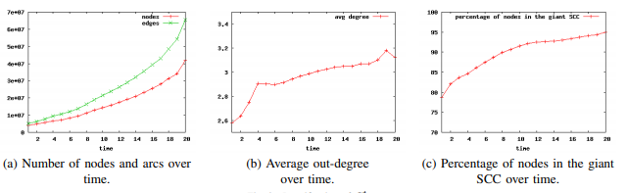
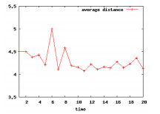
Analysis
Connectivity over Time
To analyze this 20 timestamps across 2013-2105 were selected.
First thing observed was change in number of nodes, outdegree of nodes overtime, and percentage of nodes in strongly connected component.
Another aspect was to check small world phenomenon by calculating distance between 2 nodes, interestingly diameter calculated was way bigger than that of Facebook which have lot more vertices.
BDA 7570/4060

Slide 17
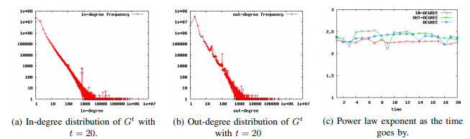
Analysis
Centrality Analysis
In this Analysis most important nodes in the network were observed over time.
The centrality of u was defined by calculating harmonic, Degree, in-degree, out-degree.
It was noted that nodes having high harmonic value also had high in-degree, out-degree.
BDA 7570/4060

Slide 18
Analysis
Richness of nodes over time
In this analysis rich gets richer hypothesis was tested
3 properties aimed to verify were:
The richest users at time t are richer than the richest users at time t’ < t.
The richest users at a certain time t tend to remain the richest at time t’ > t
The richness gets more concentrated with the progression of time
BDA 7570/4060

Slide 19
Conclusion
The paper “Uncovering the Bitcoin blockchain: an analysis of the full users graph” focuses on the analysis of User graph created using clusters of addresses which corresponds user.
It shows the results of analysis on user graph over the evolution of time.
The analysis shows interesting results on hypothesis proposed in richness properties of the bitcoin network.
BDA 7570/4060

Slide 20
Questions
Which is presently the biggest bitcoin exchange and how much % of volume it handles?
How can we validate if a given address is bitcoin address or not?
For reference: https://medium.com/coinmonks/bitcoin-address-validation-on-python-a0123ba3adb8
BDA 7570/4060

Slide 21
THANK YOU
BDA 7570/4060

